Slide 1
DATABASE MANAGEMENT SYSTEM
COURSE BASED PROJECT

Slide 2
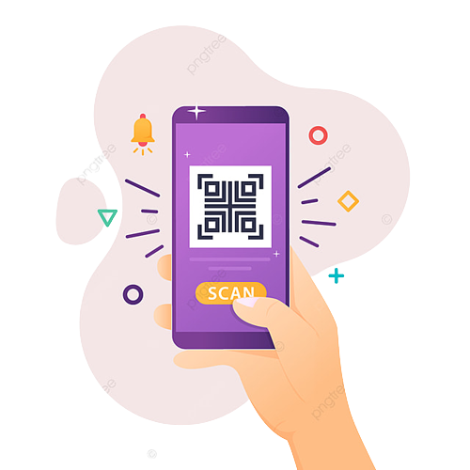
QR PAYMENTS SYSTEM

Slide 3
TEAM MEMBERS
1. K. SANTHOSH KUMAR | 20071A6620
2. M. SAI RITISH | 20071A6626
3. M. UDAY KRISHNA | 20071A6627
4. M. HARIKESH | 20071A6629

Slide 4
INTRODUCTION :
This project “QR Payments System” is made with the motive of enabling user to make digital payments when he is offline. This project is restricted to the premises of our college canteen area. We are motivated to solve this problem when we faced the problem in making our UPI payments while ordering food in college canteen. Due to lack in internet services making a UPI payment is very hard.
The survival of this project is with few assumptions like:
The college maintains student account where user deposit his pocket money.
The food stall owners were provided with internet connectivity (Wi-Fi) by the college.
Student has an all time updated QR Generation app on his device to make payments successful.
This project has two distinct products and their implementation. The first product is a QR Generator used by students. The second product is a QR Scanner used by food sellers.

Slide 5
How students use QR Generator?
Students use the QR Generator app ( as of now is a hosted web application ) to generate QR codes. This QR codes represent the user's food orders. User while having the internet connectivity gets himself logged in to this application. And even when he is offline user can generate QR codes. This stores data regarding food stalls, food items and it’s prices. User can select his food quantity and enter pin while generating the QR code. This pin will be encrypted before encoded in the QR code. Thus user can make his food order as a QR code. Username ( his roll no ) is included in the QR code as he is logged into the app. This is made with the intention to replace any order taking touch panels to decrease equipment cost.
How sellers use QR Scanner?
The food sellers will have the QR Scanners installed at their desk. This helps in taking the student food orders. This QR Scanner will decode the QR code and understand the user food order and extract the user credentials and validate the user. After validating the user, the system validates the QR code based on it’s time of generation and try to re-use status. Upon successful validation of QR code on checking for sufficient funds in user account transaction will be completed.

Slide 6
TECHNOLOGY STACK :
QR Generator Application:
Front-End:
HTML5.
Bootstrap.
CSS.
JavaScript.
Server-APIs:
Flask.
QR code:
pyqrcode (python module to generate a QR code).
QR Scanner Interface:
pyzbar (a python module to scan QR codes).
opencv-python.

Slide 7
REQUIREMENTS :
Functional Requirements:
Login.
Food stall data.
Pin encryption.
Single time usage of a QR code.
QR must be valid for limited time.
Download QR code.
Validate User.
Check for sufficient funds from user.
Complete transaction only if all database transactions are done without fail.
Generate Bill.

Slide 8
Non-Functional Requirements:
Usability:
we get the response within seconds.
The software must have a simple, user friendly interface so customers can save time and confusion.
Reliability:
The system is more reliable because of the qualities that are inherited from the chosen platform java. The code built by using java is more reliable.
Implementation:
The system is implemented in a cloud based hosting service called heroku.

Slide 9
Supportability:
The system is designed to be the cross platform supportable. The system is supported on a wide range of hardware and any software platform which is having python interpreter built into the system.
Interface:
The user interfaces are the web pages which are developed using the HTML and other styling frameworks.
The interface design is aimed at a flexible front-end communication to provide the user with clear information in navigating a user-friendly interface is planned.

Slide 10
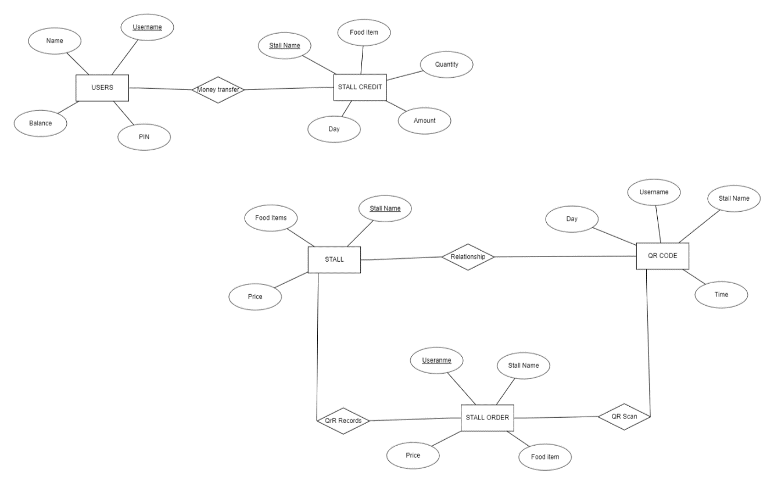
ER DIAGRAM:

Slide 11

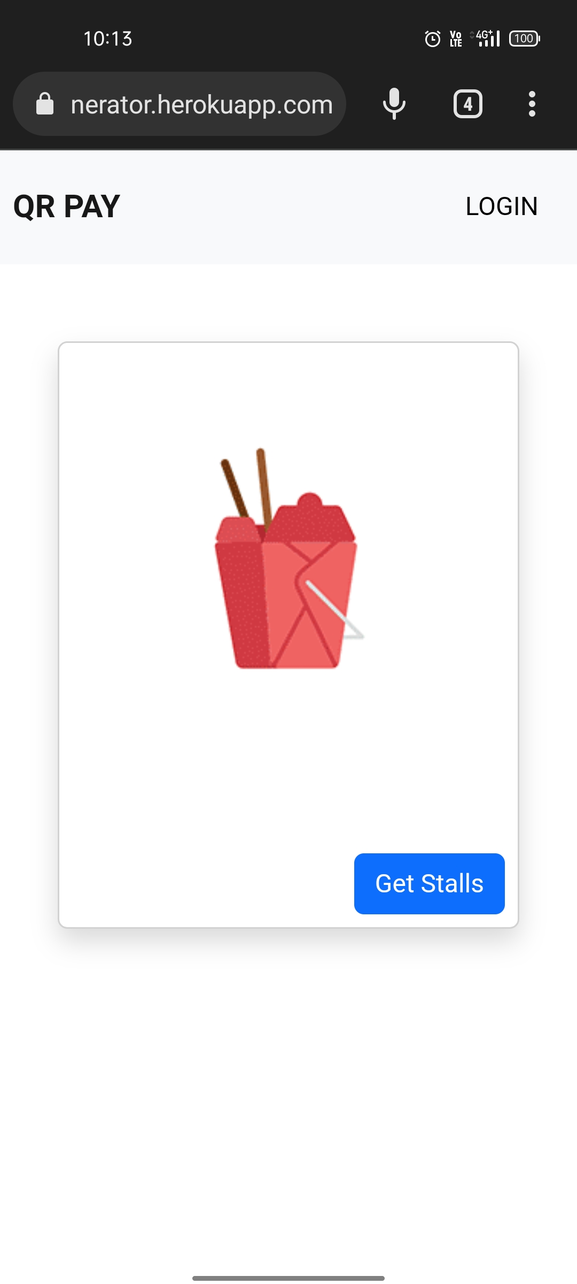
RESULTS :
The QR Generator App:
Home page:

Slide 12
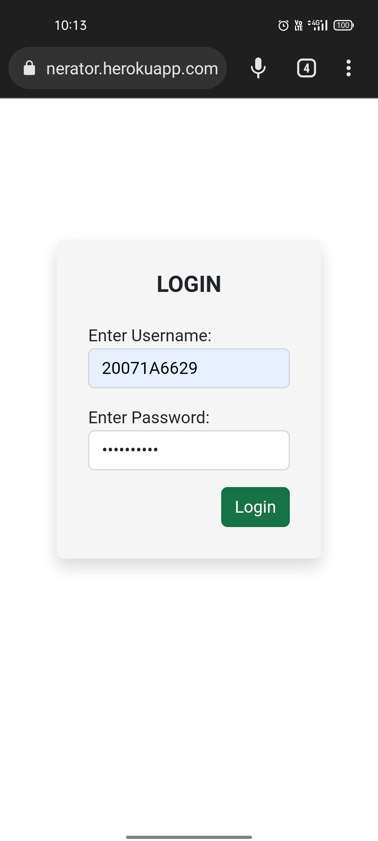
Login Page:

Slide 13
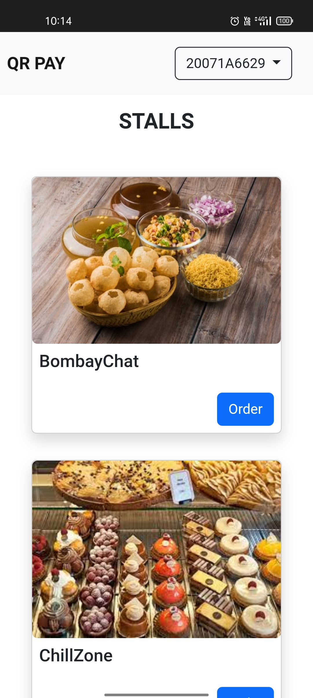
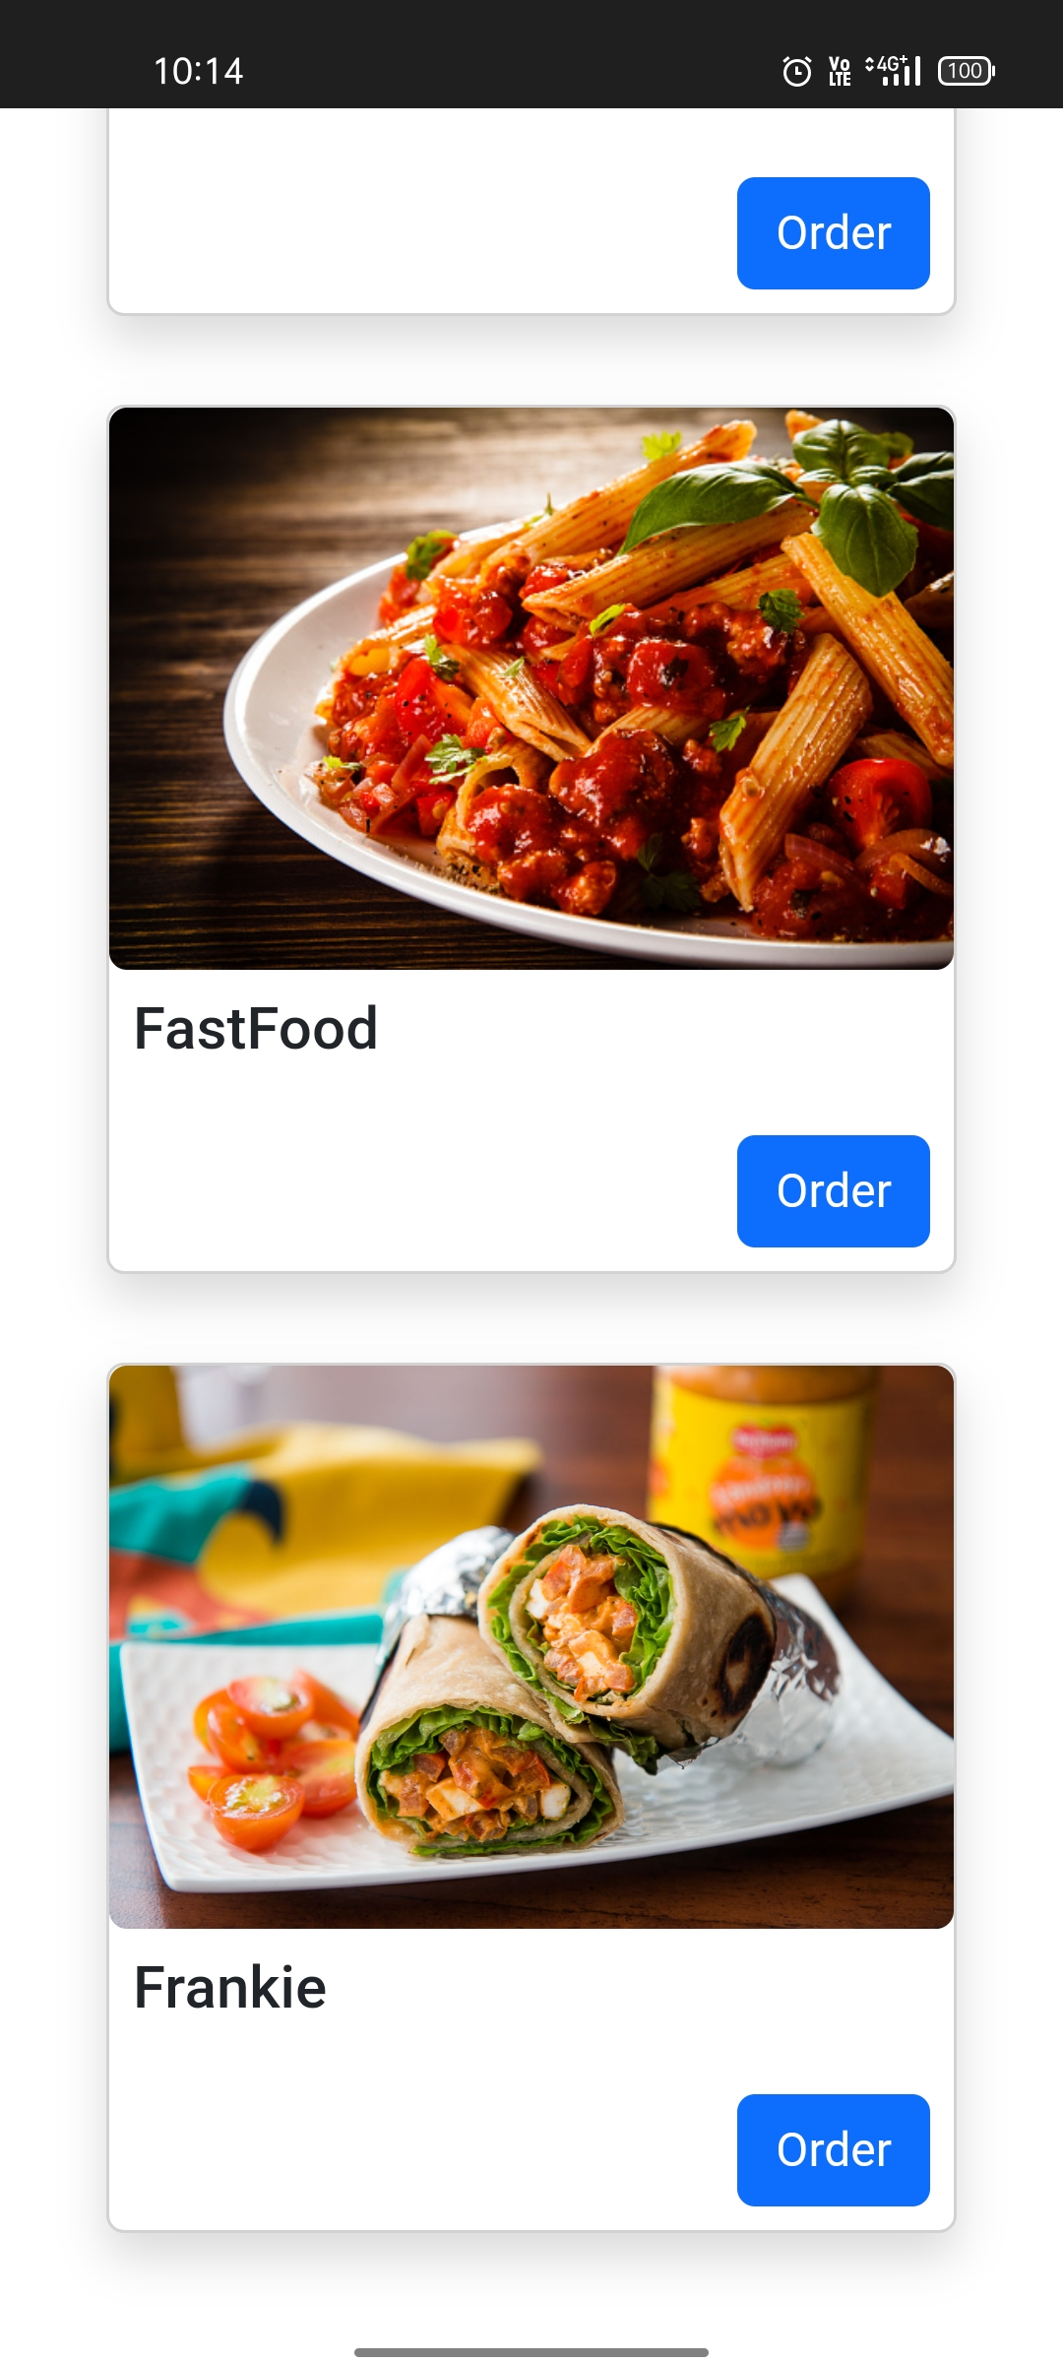
Stalls Page:

Slide 14
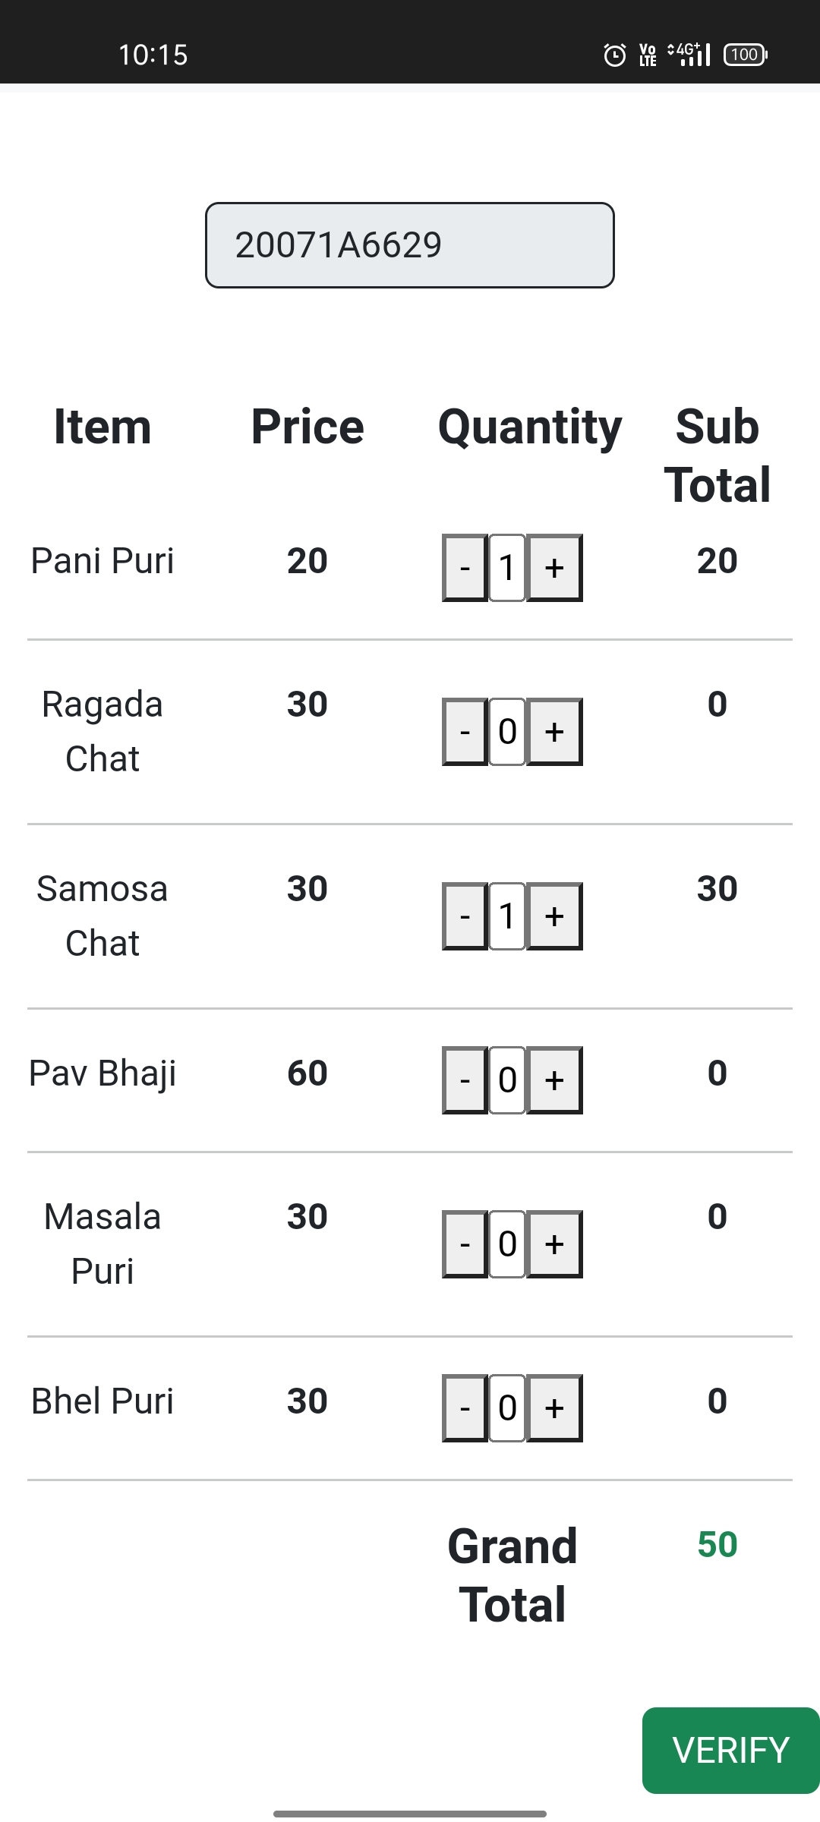
Order Food Page:

Slide 15
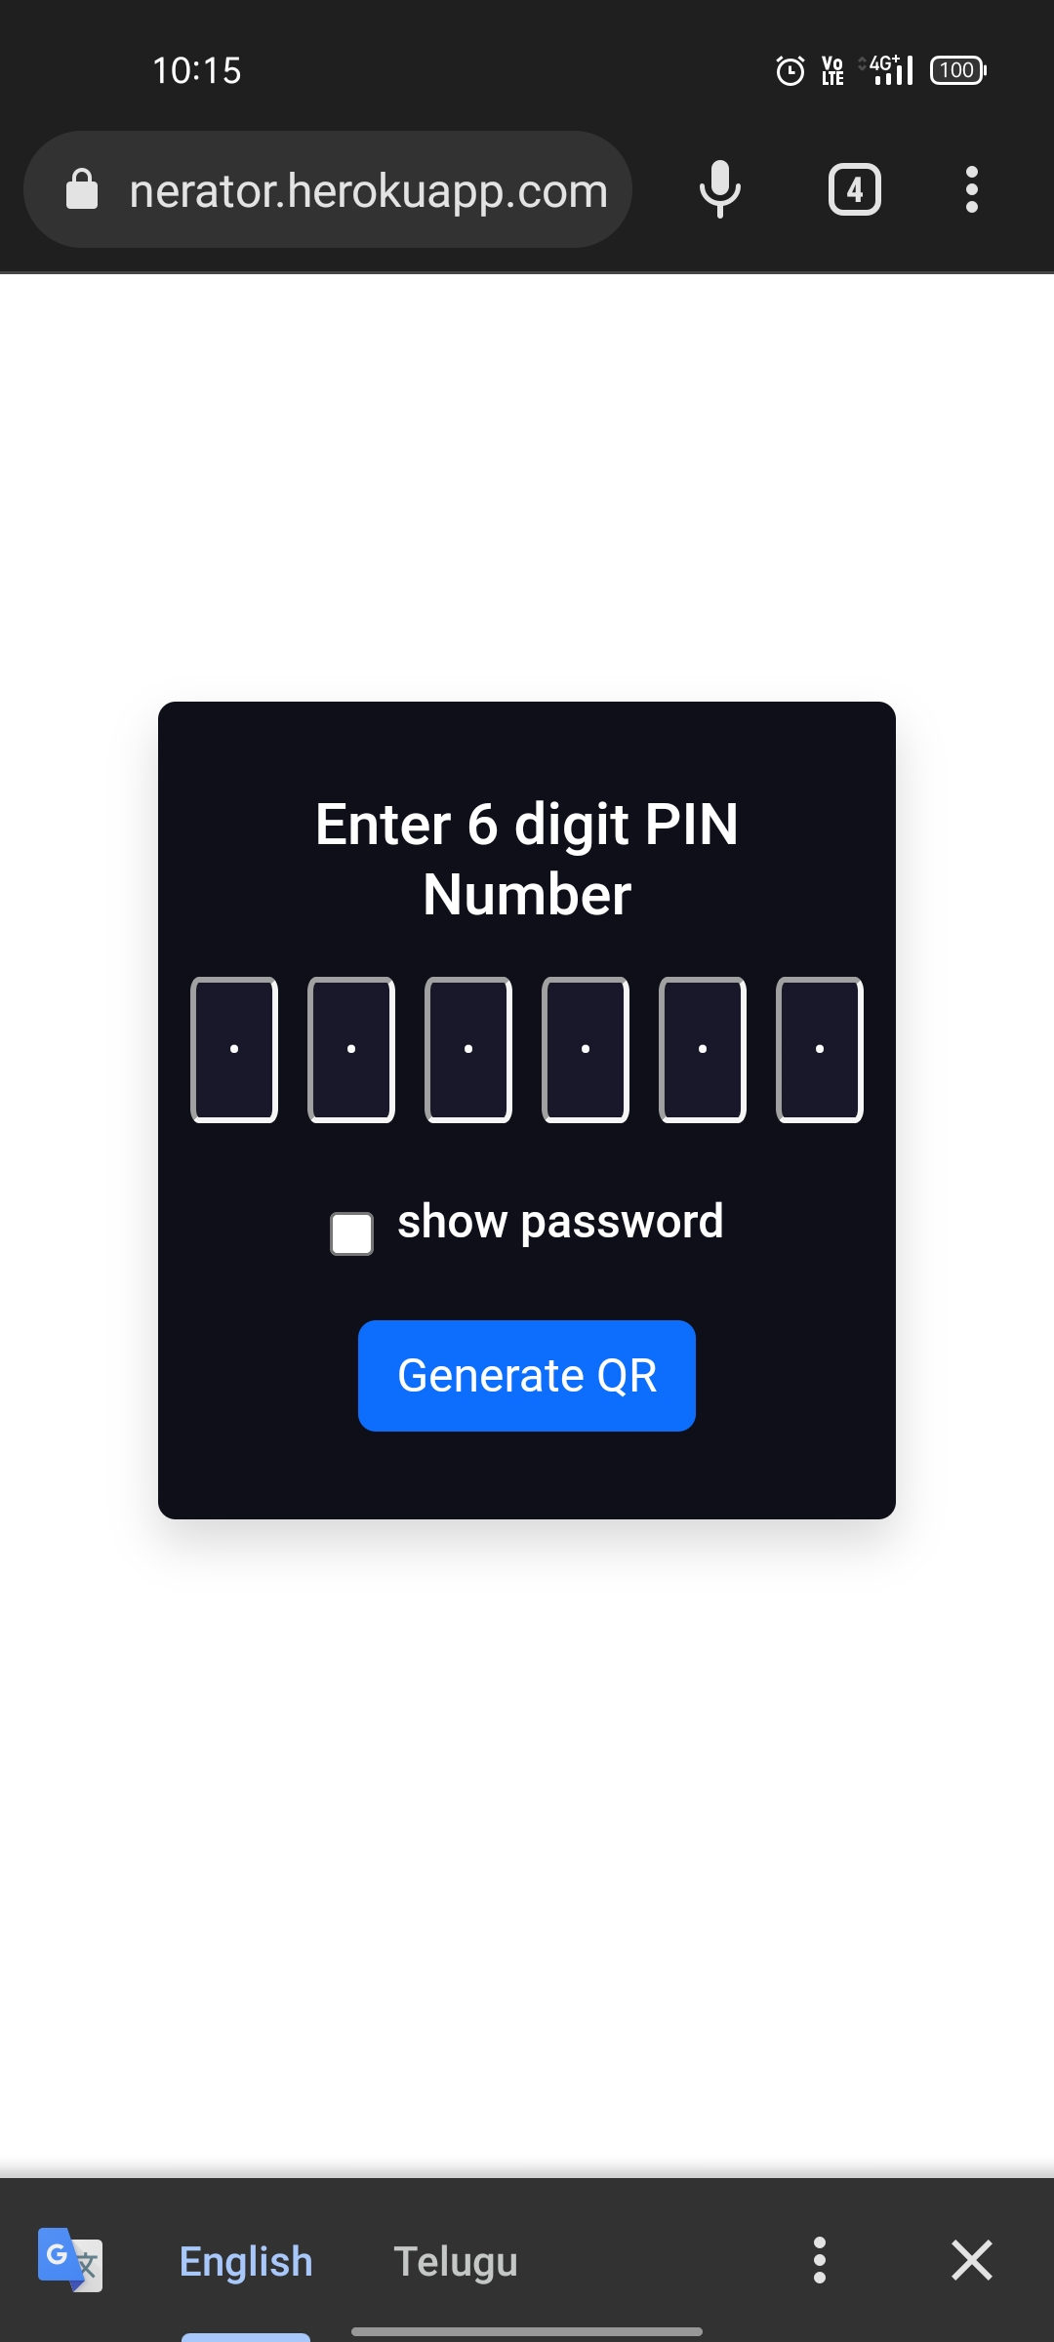
Enter Pin Page:

Slide 16
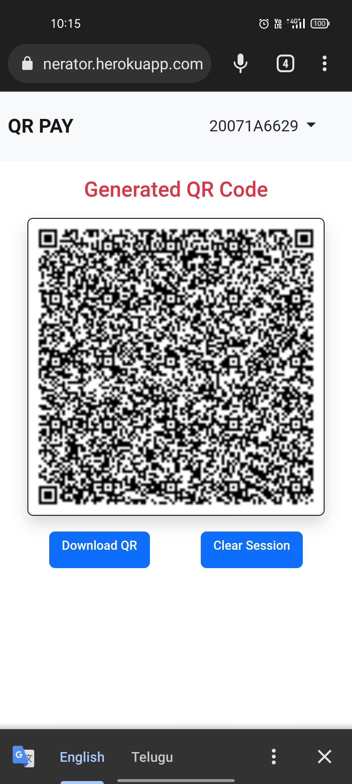
QR Display Page:

Slide 17
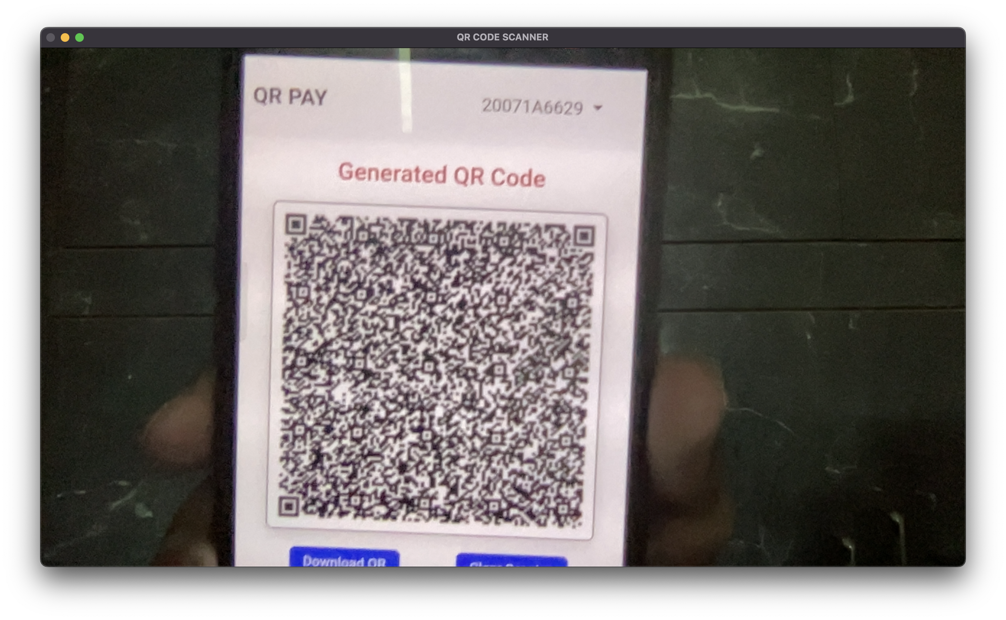
The QR Scanner Module:
QR Scanner:

Slide 18
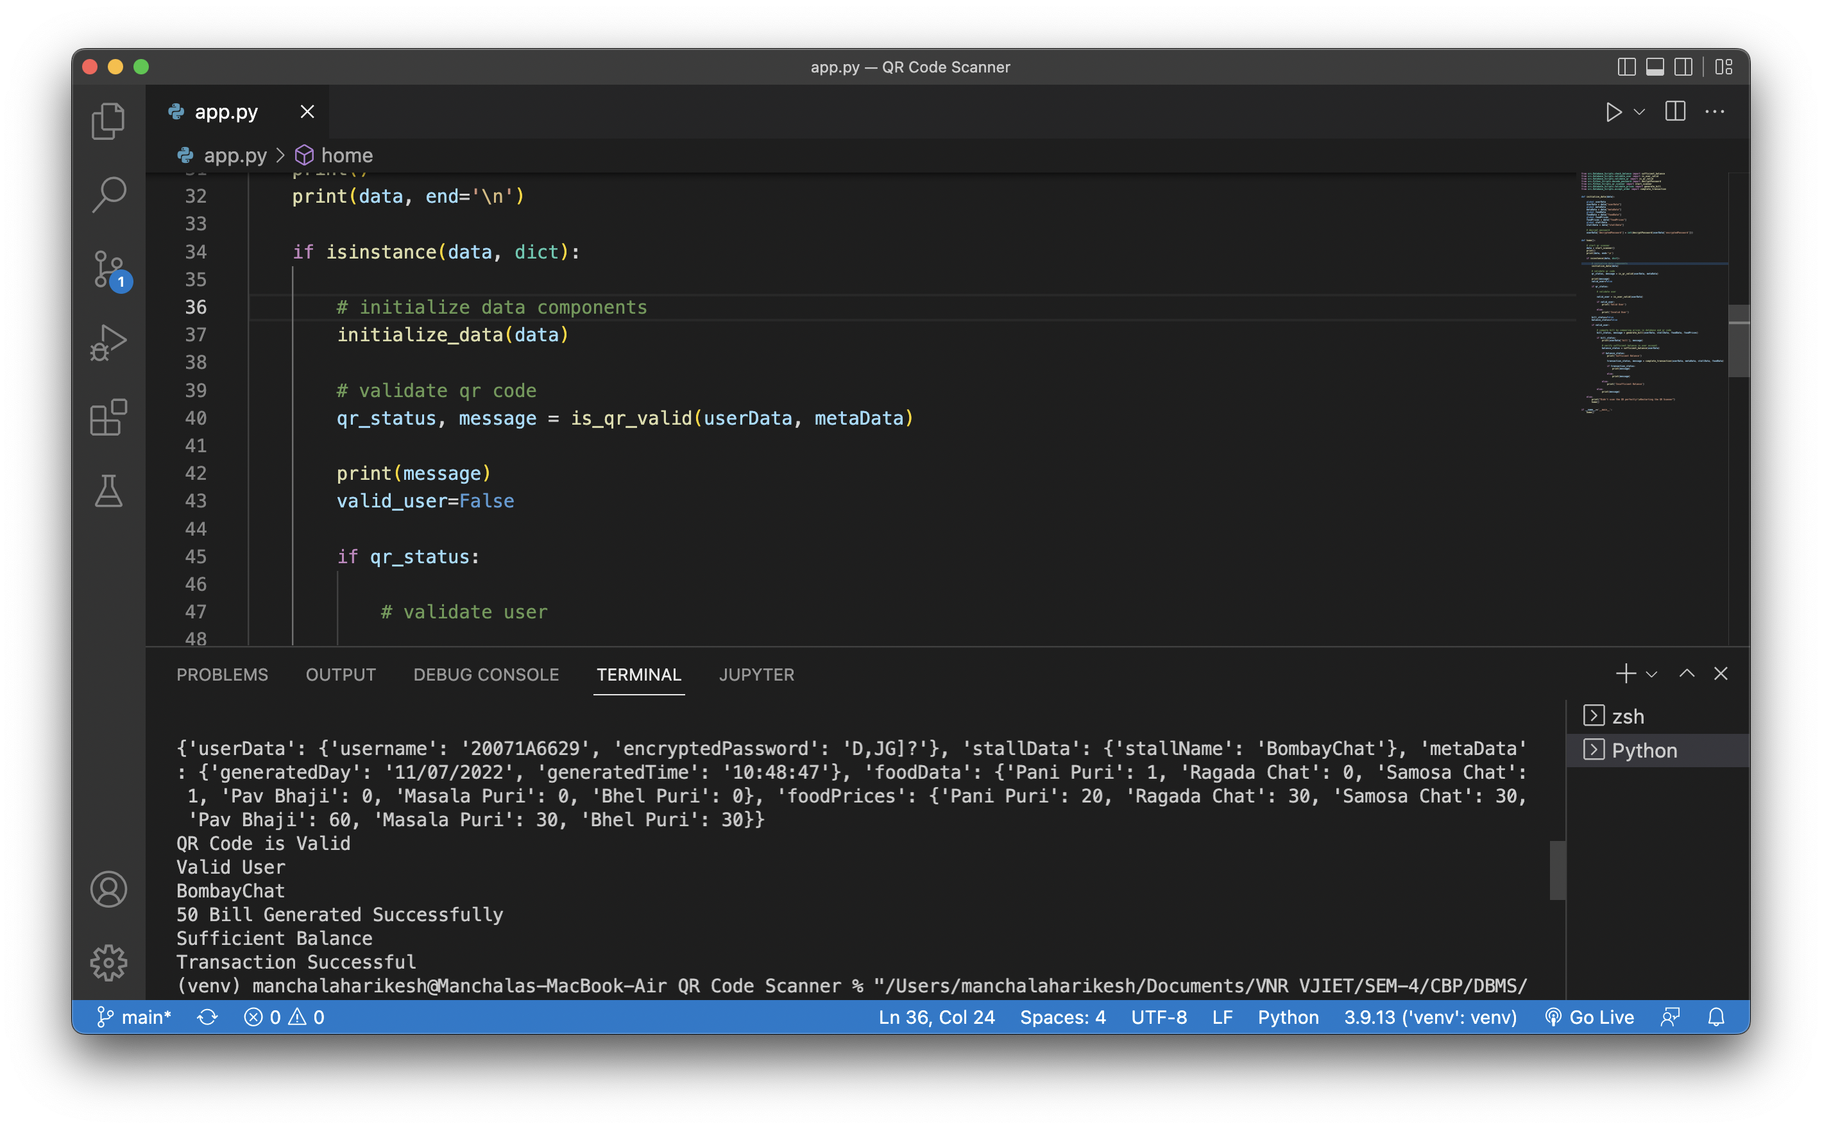
QR Scanner Result (scanning QR for first time):

Slide 19
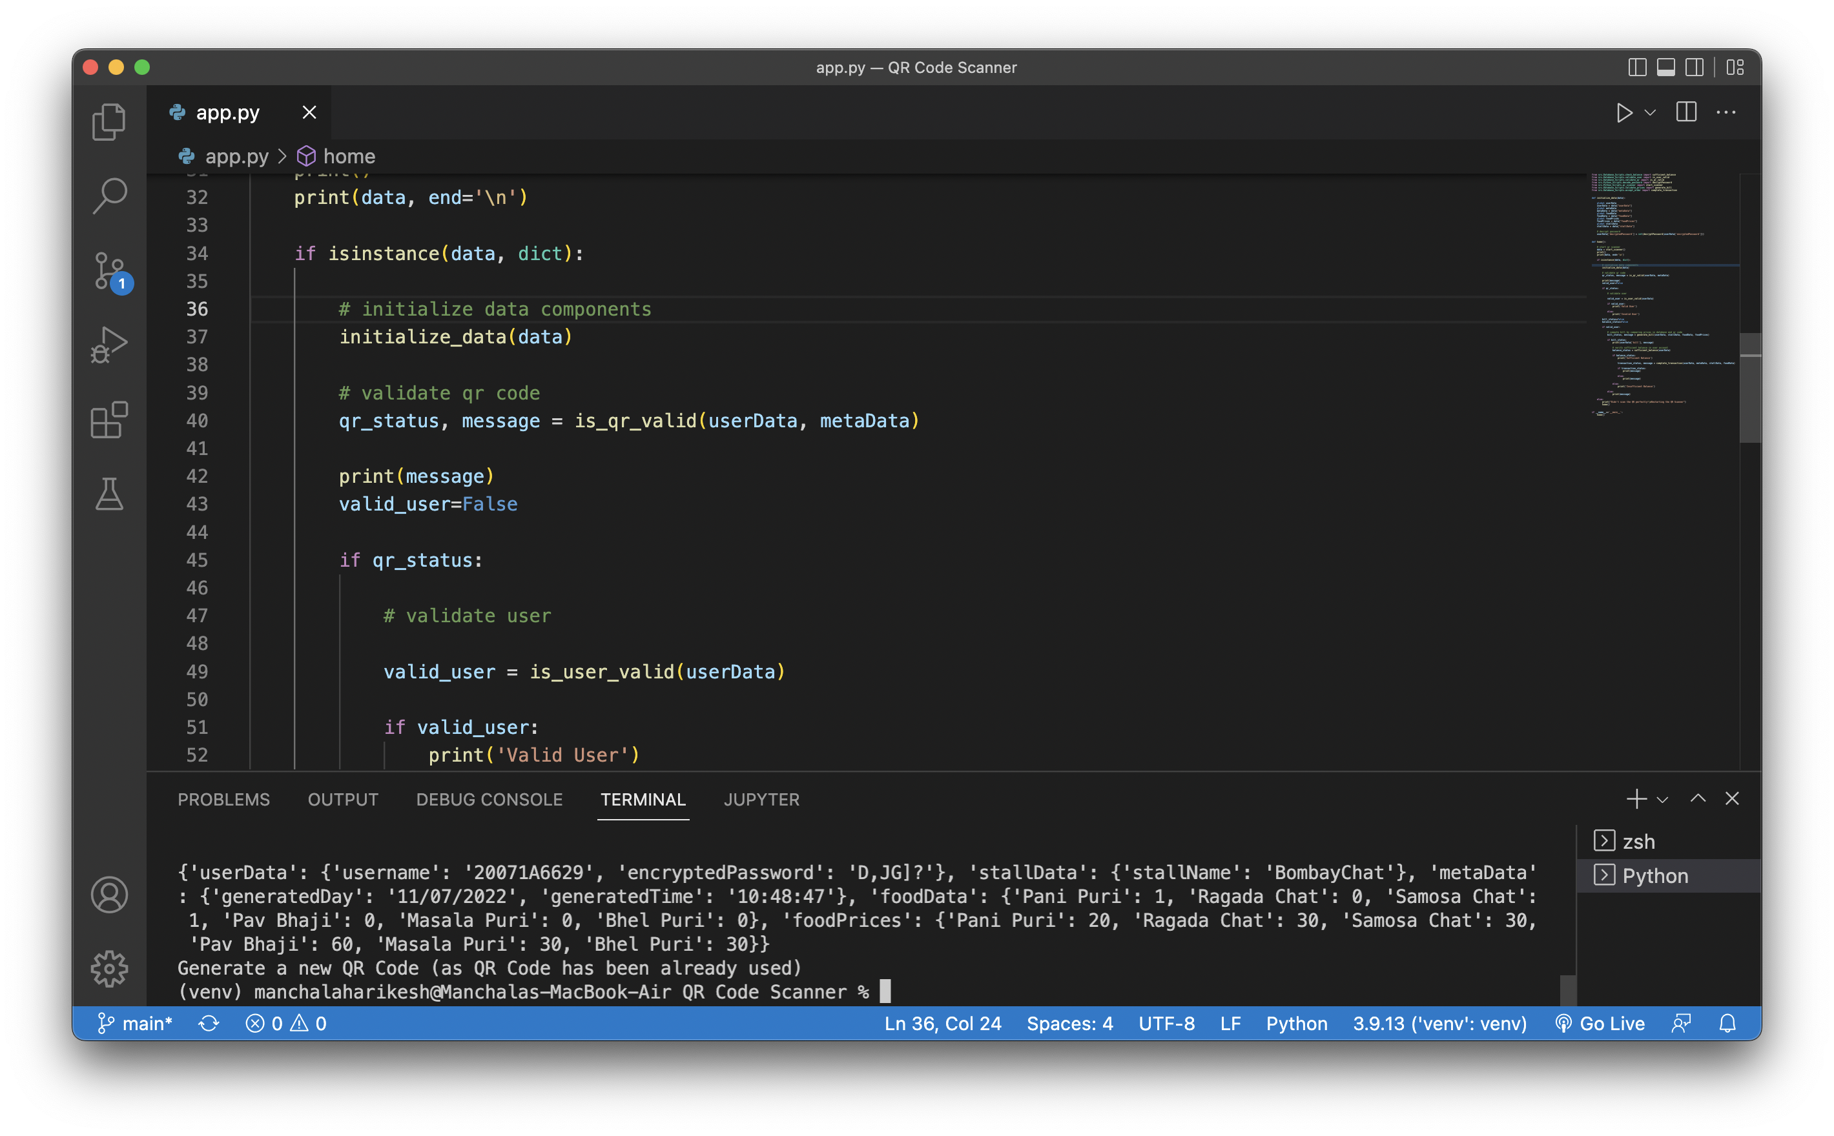
QR Scanner Result (scanning QR for second time):

Slide 20
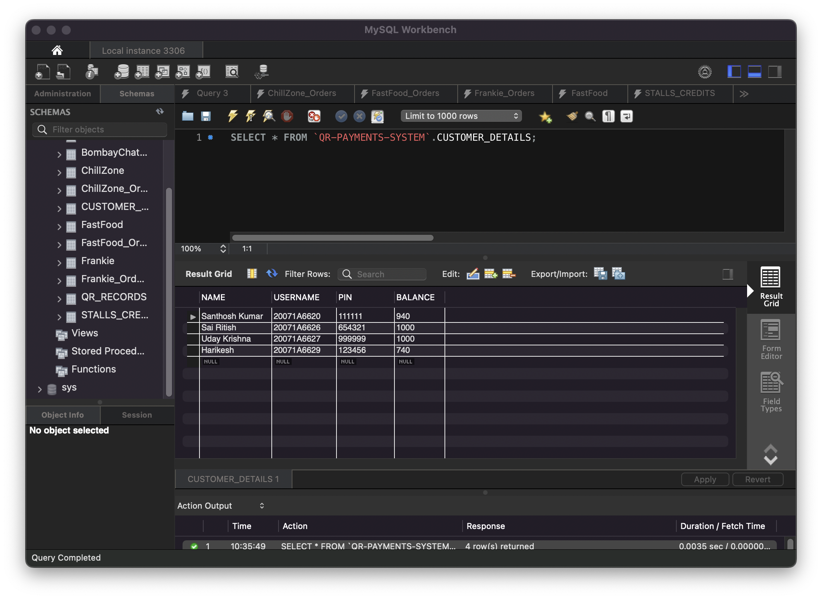
Database Schemas:
Customers Details:

Slide 21
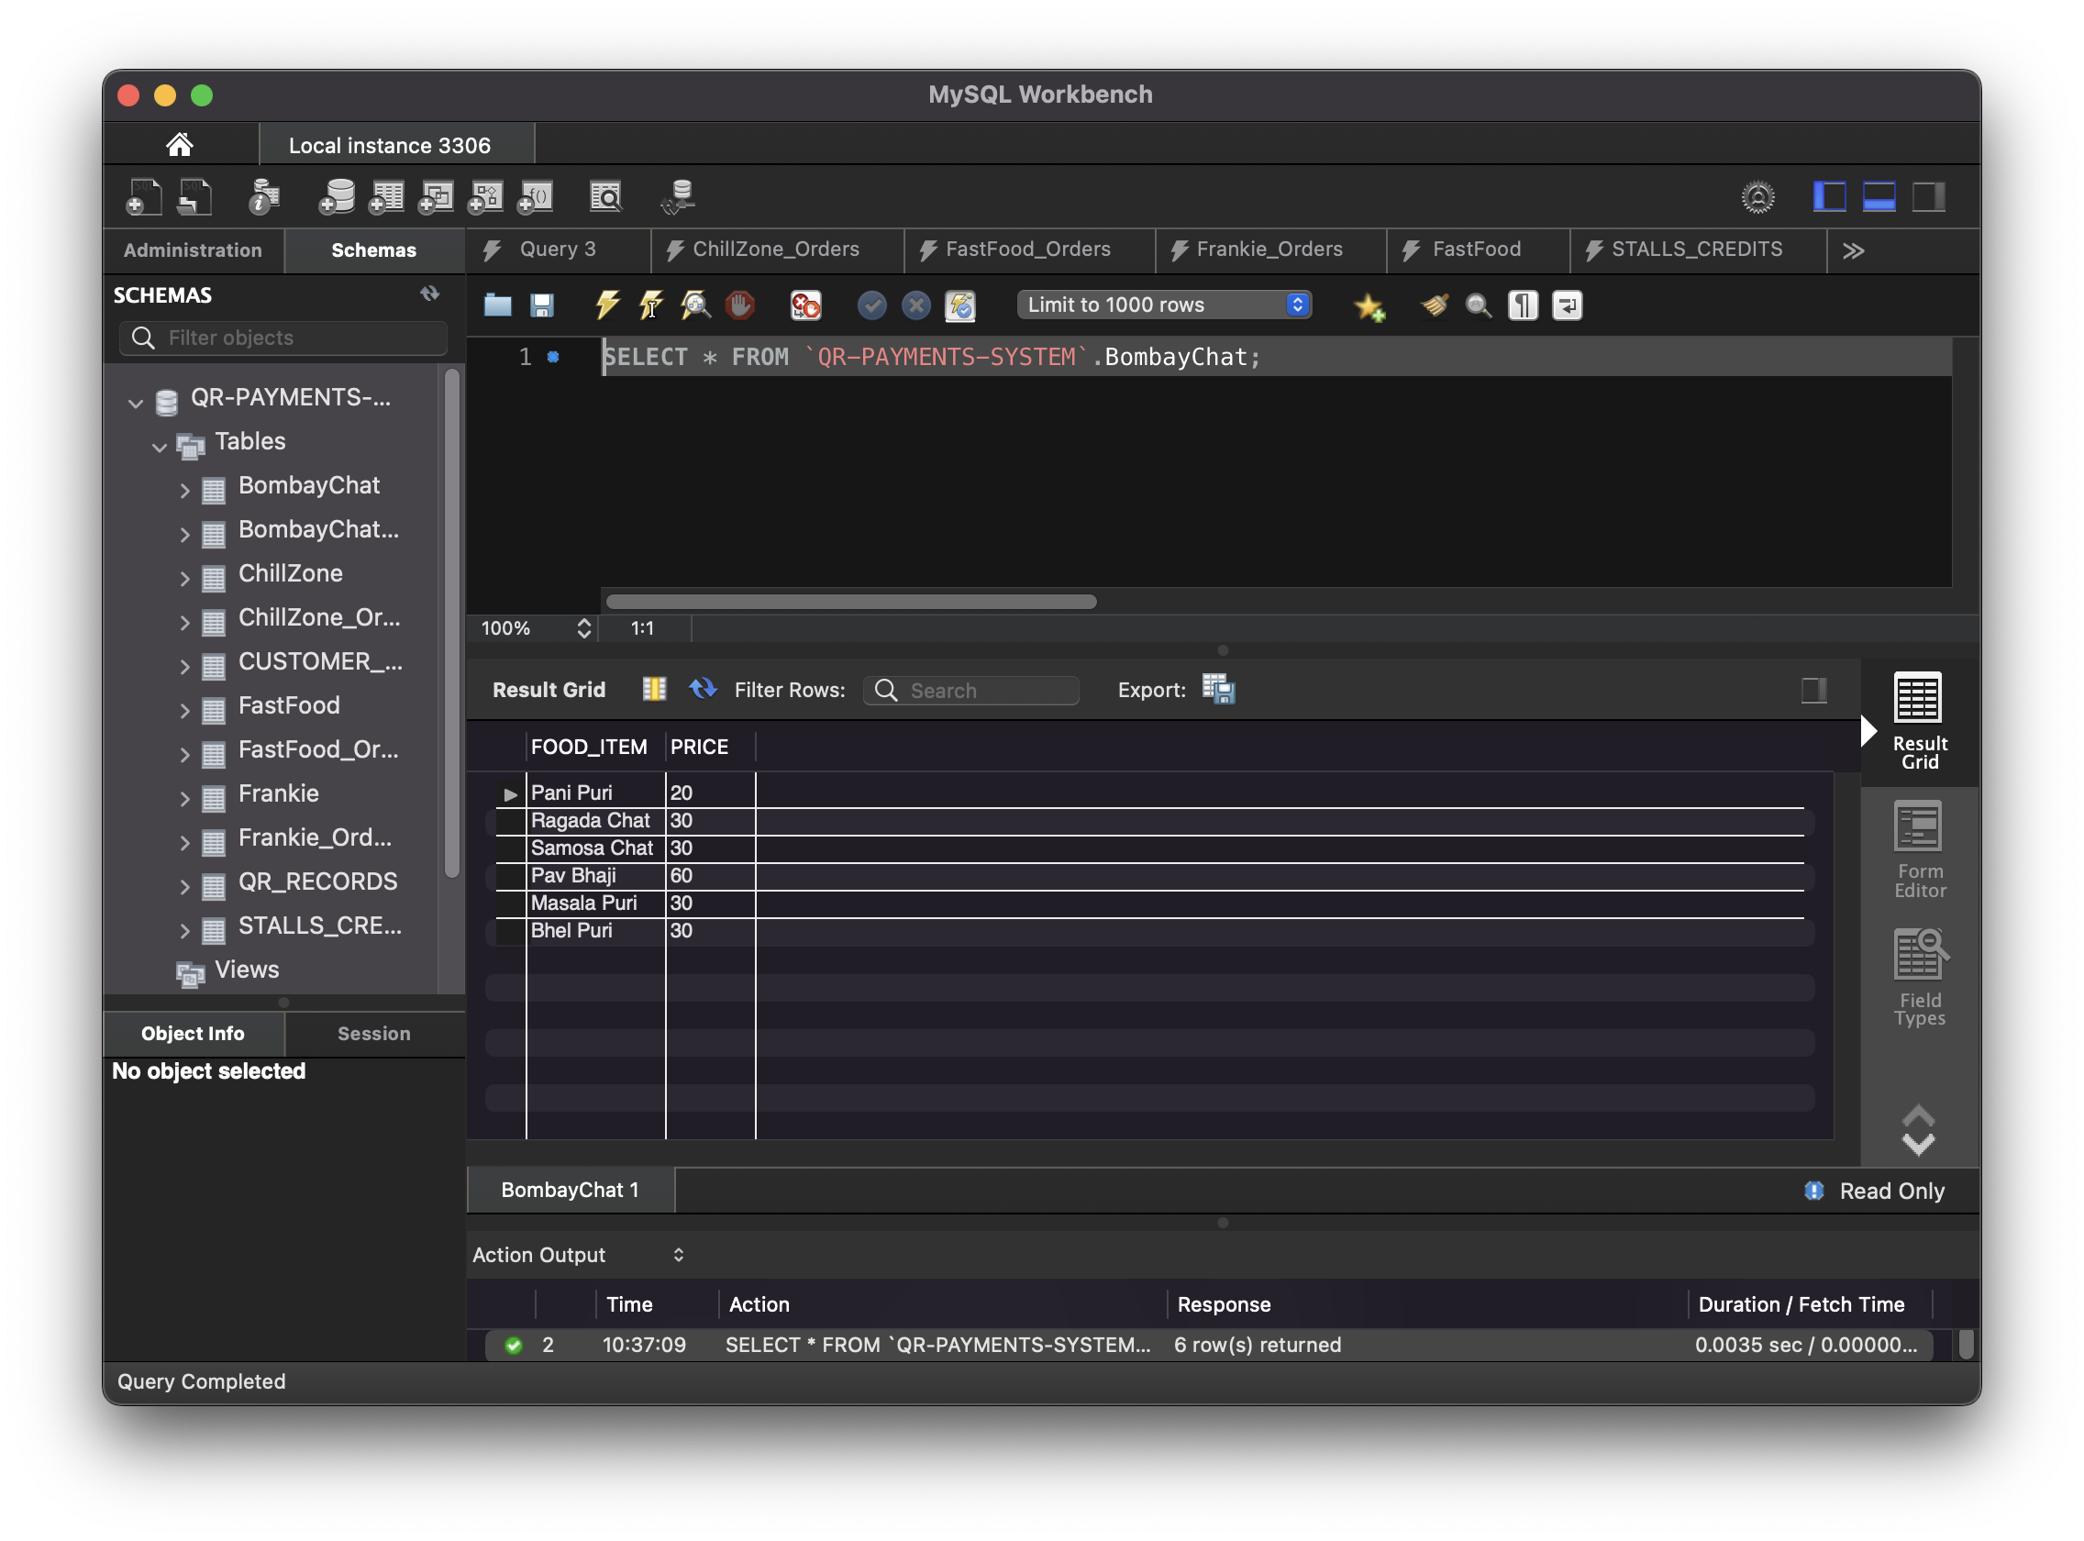
Food Stalls Tables:
Bombay Chat:

Slide 22
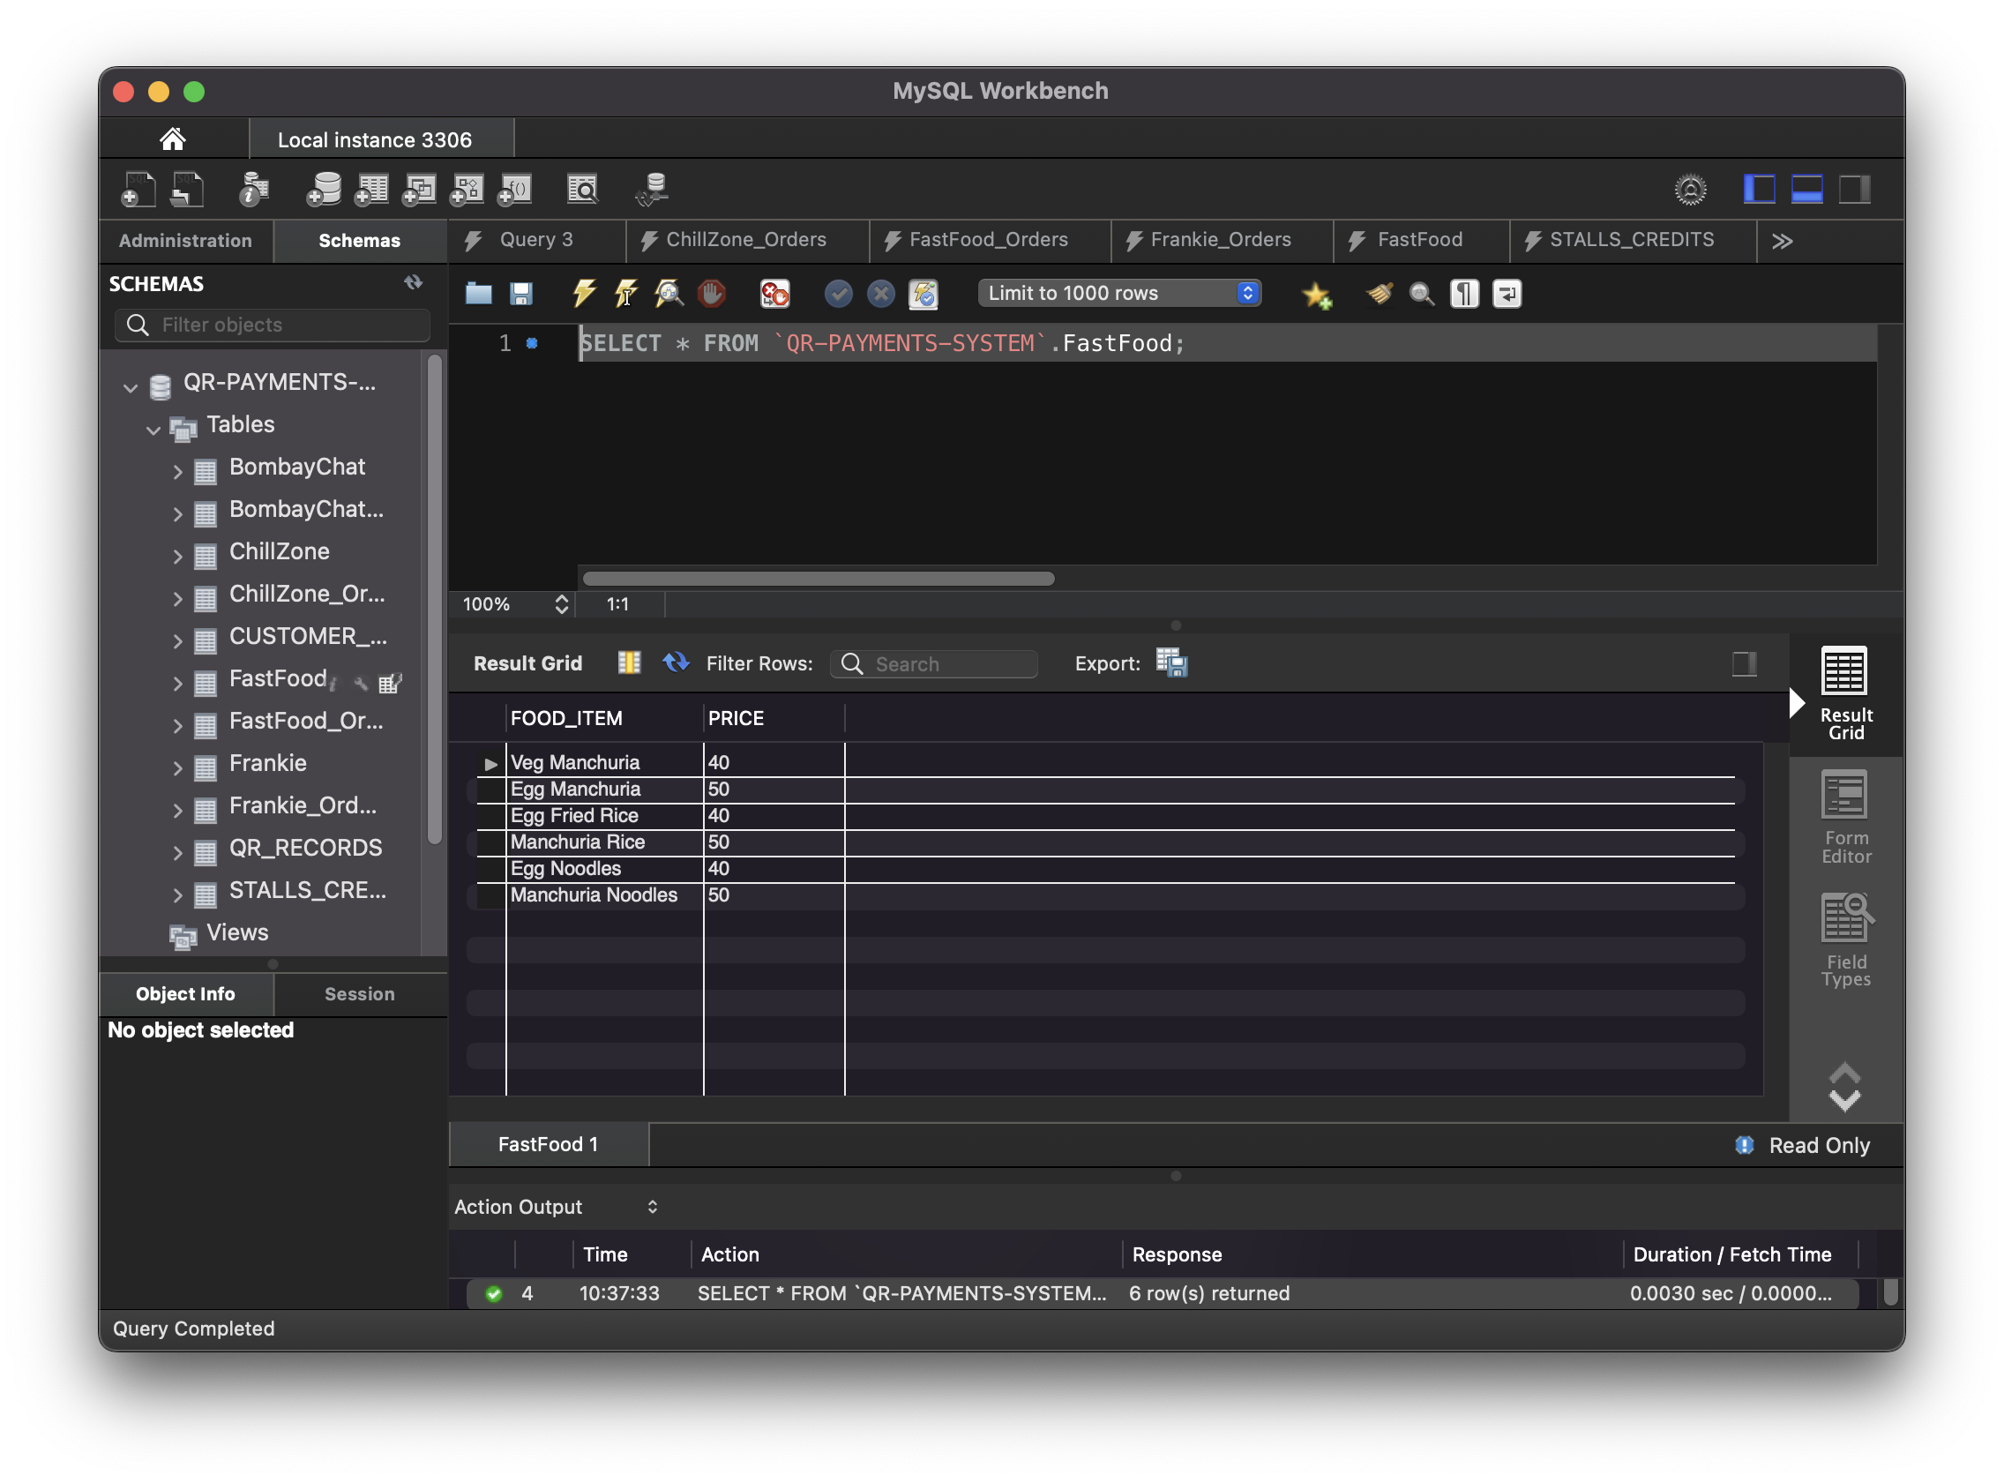
Fast Food:

Slide 23

ChillZone:

Slide 24
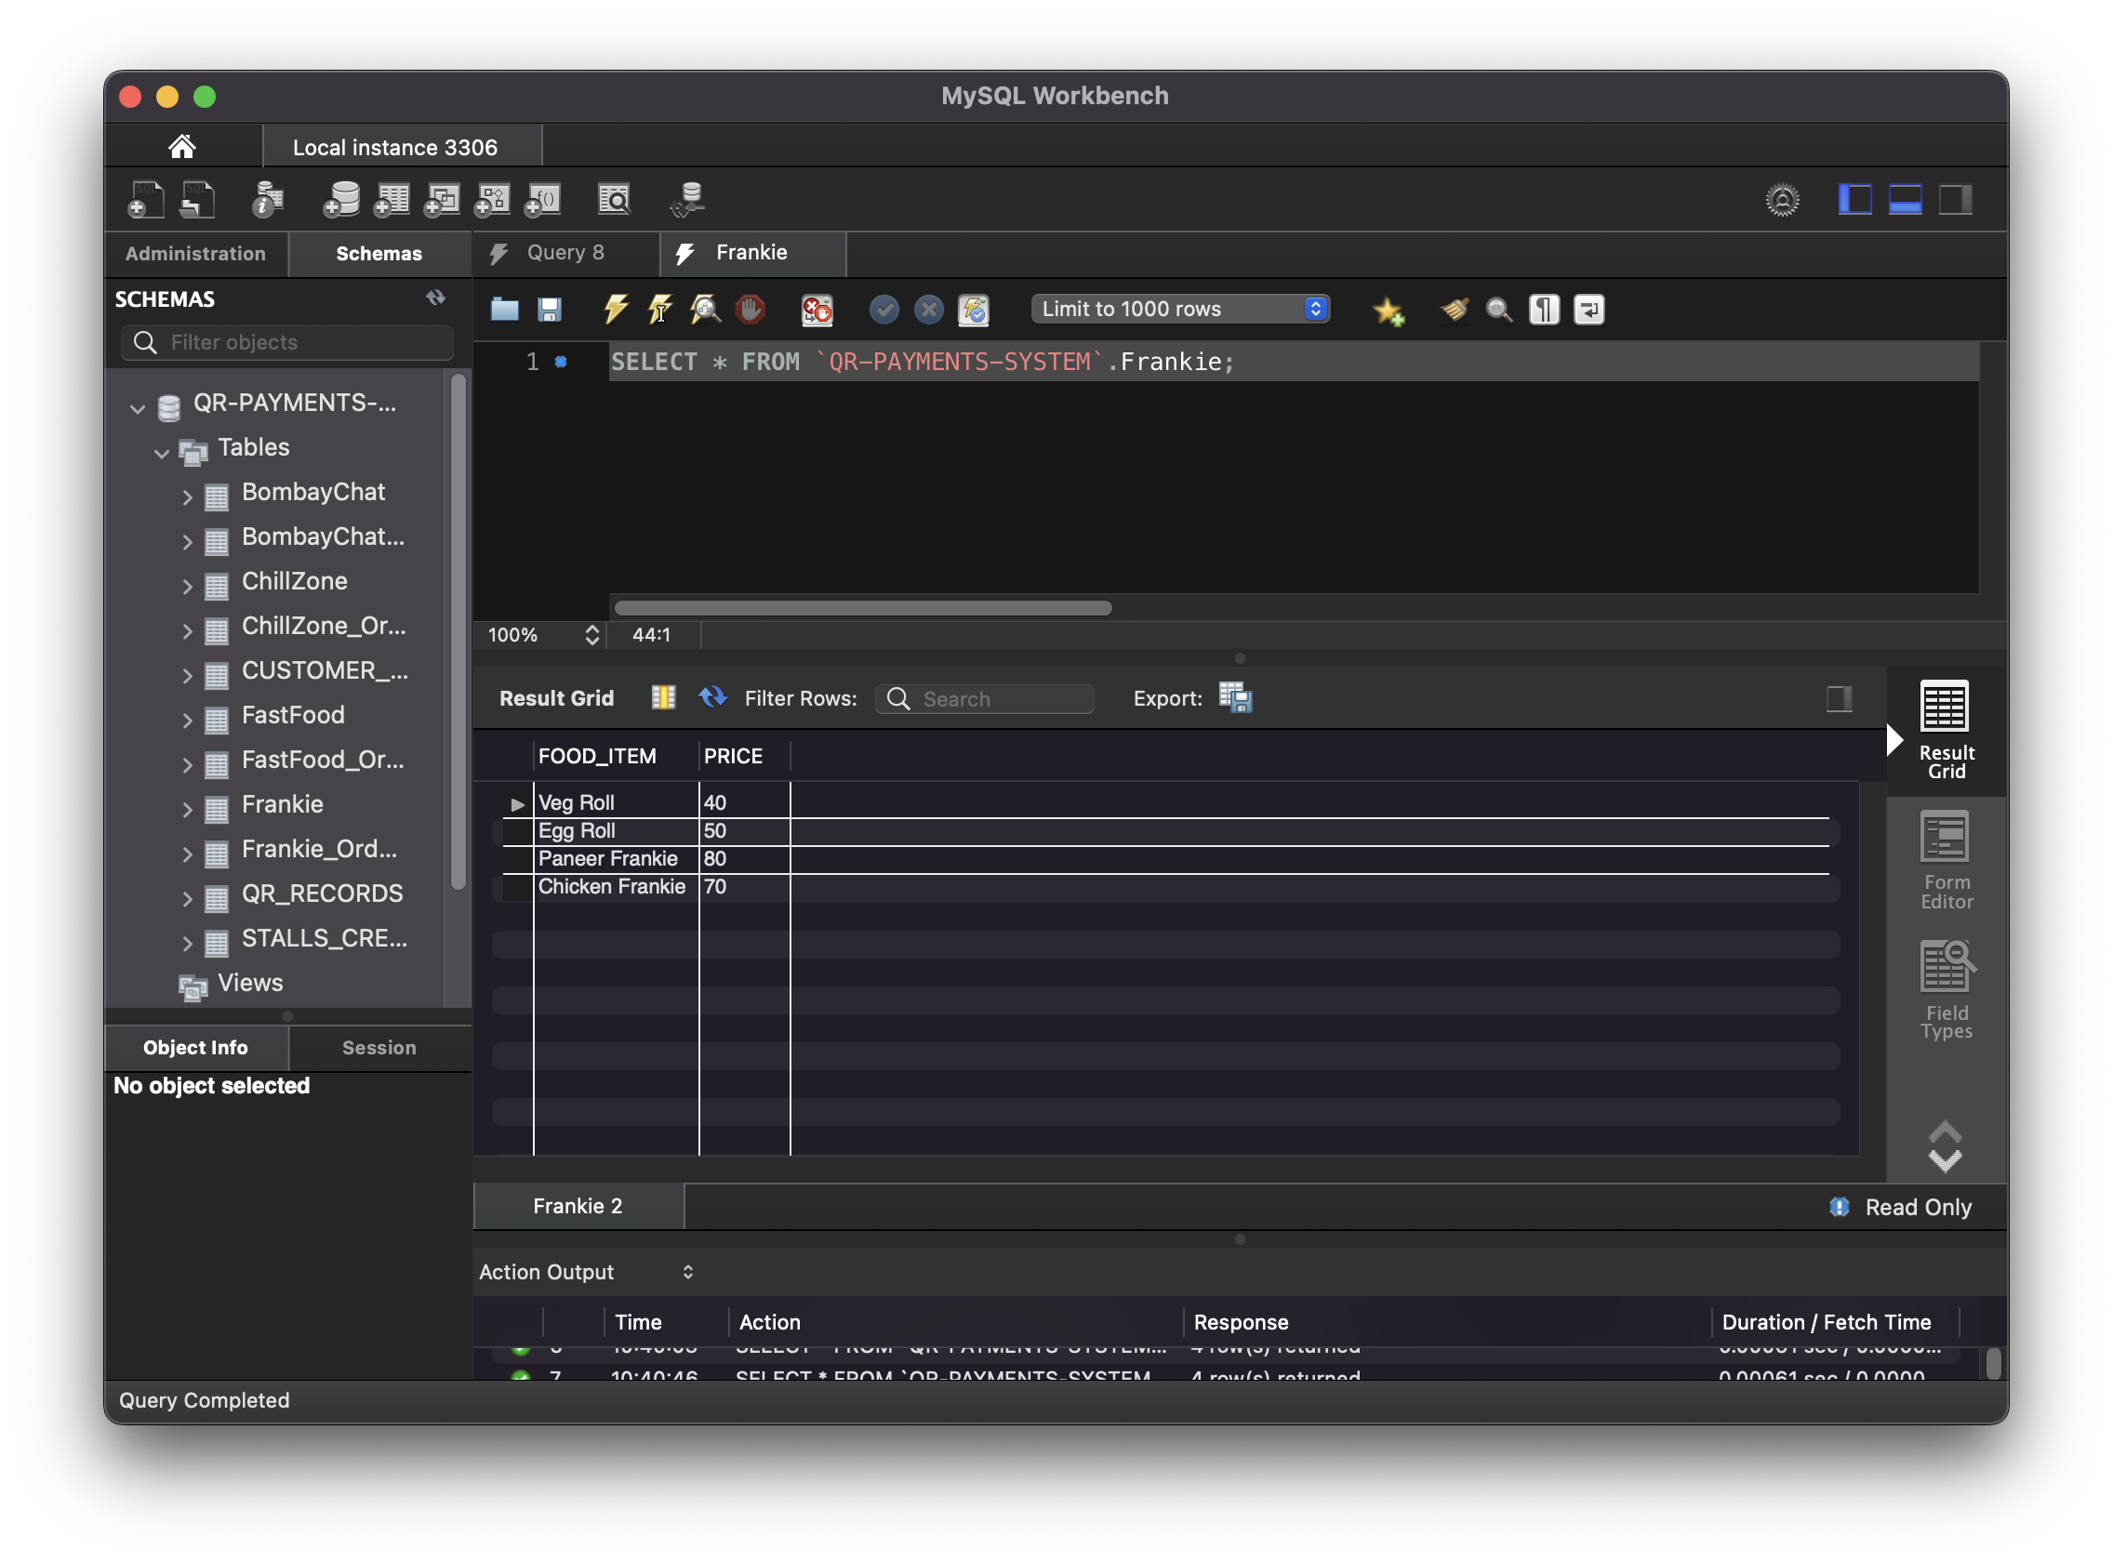
Frankie:

Slide 25
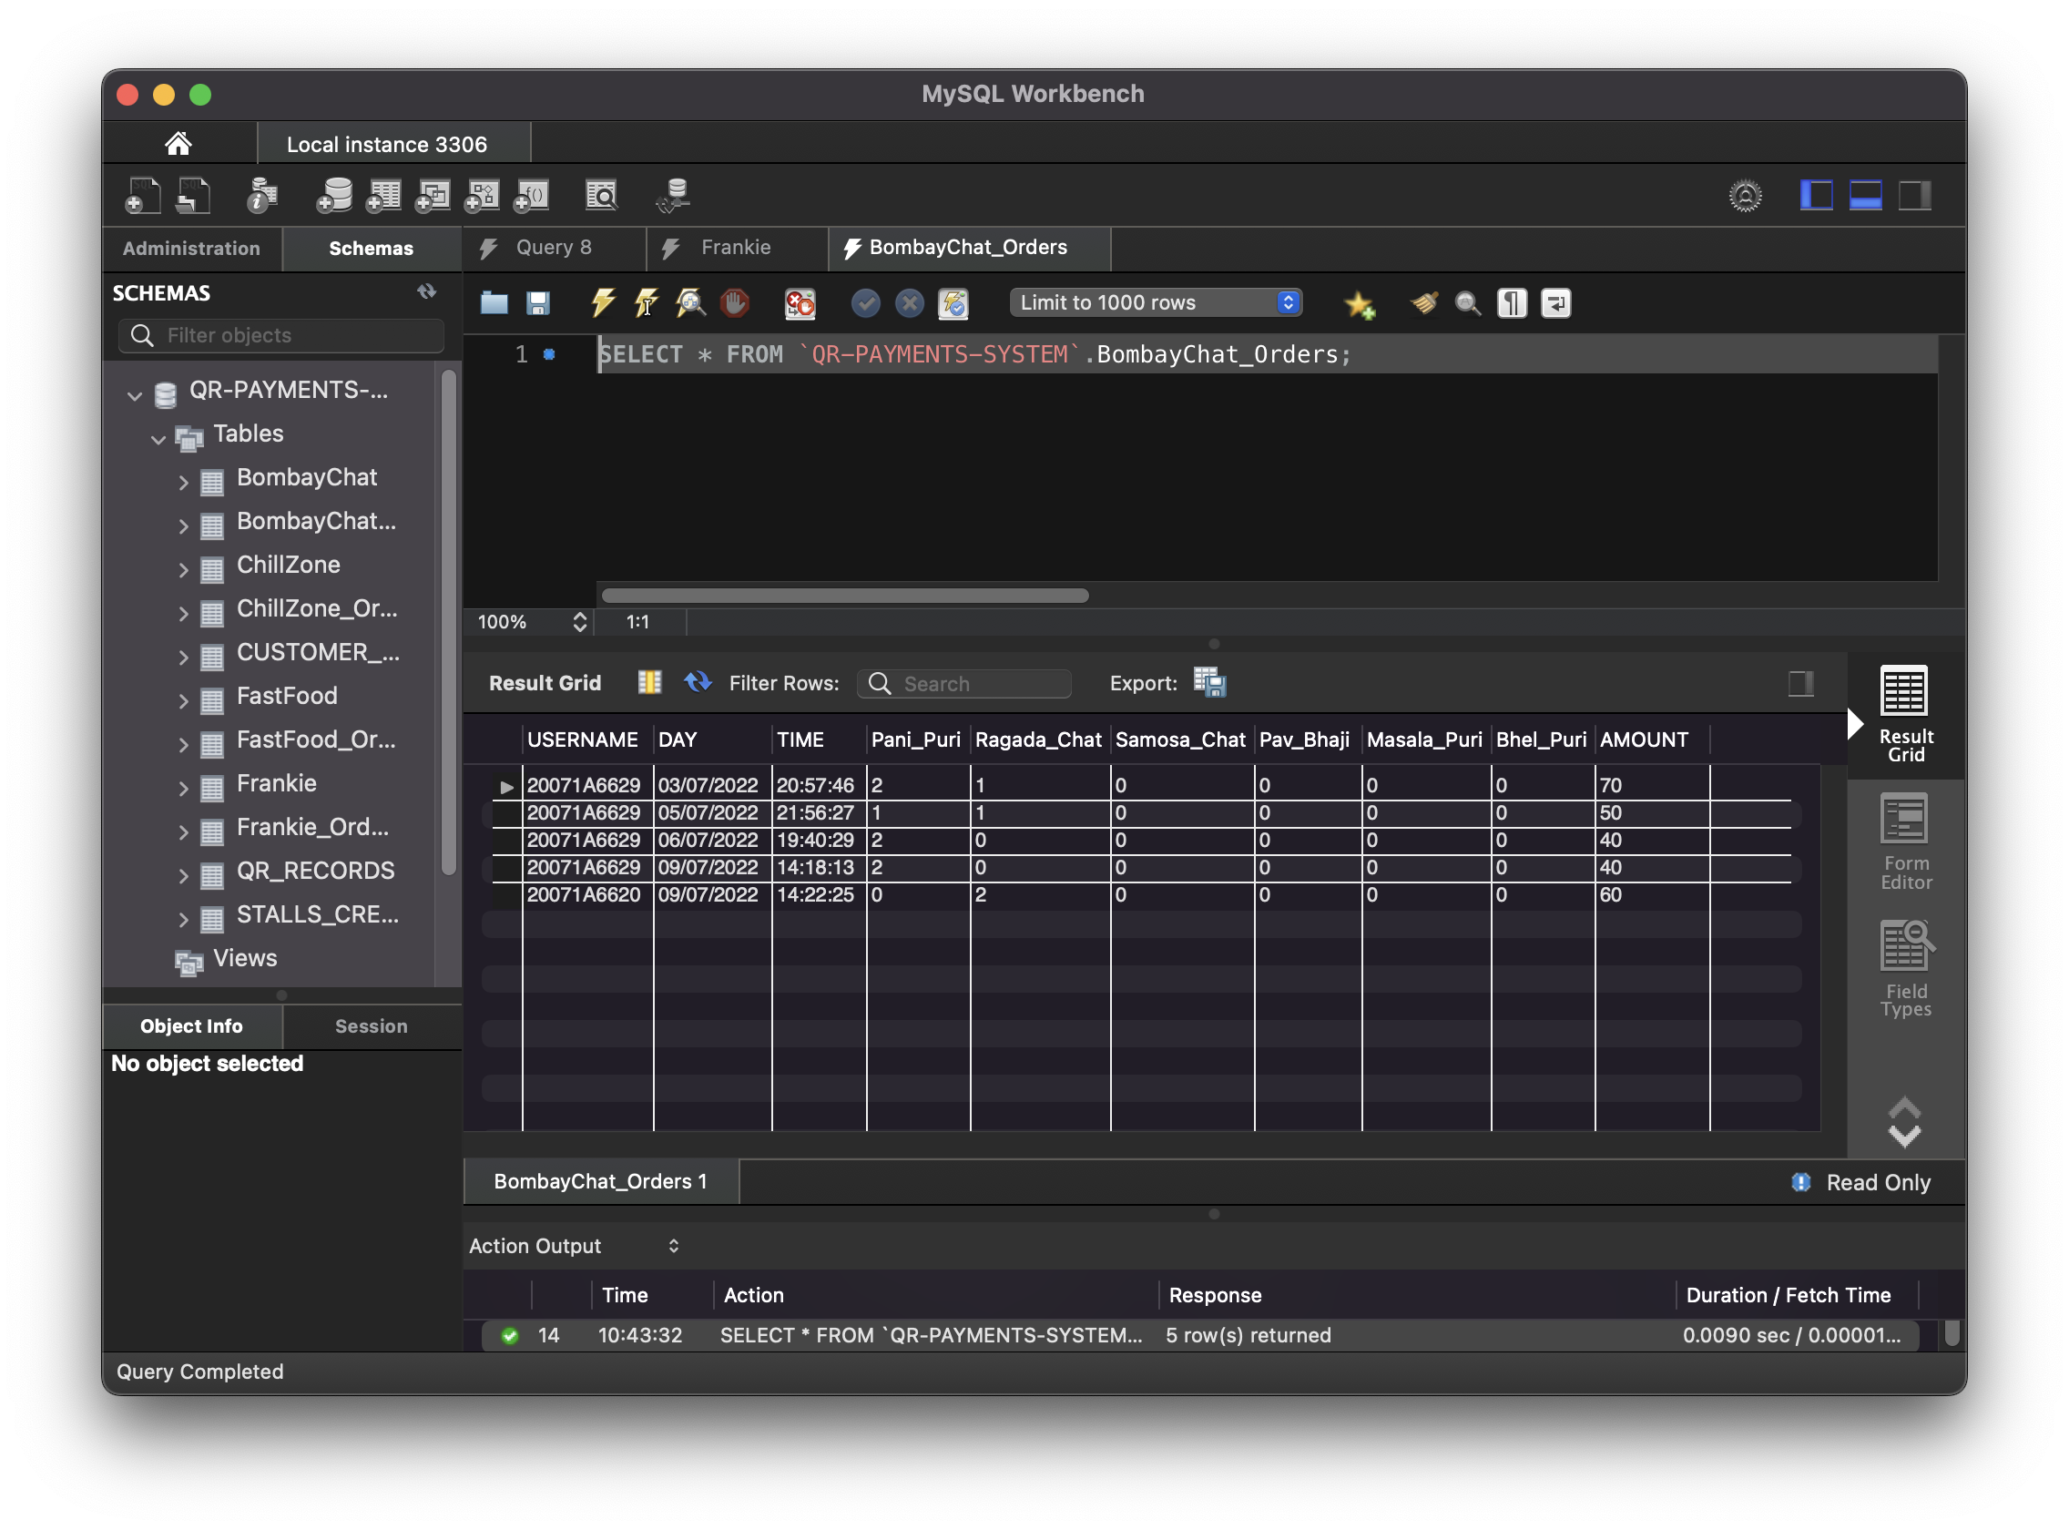
Bombay Chat Orders Table:
This able stores the details of order details of the
Bombay chat food stall.

Slide 26
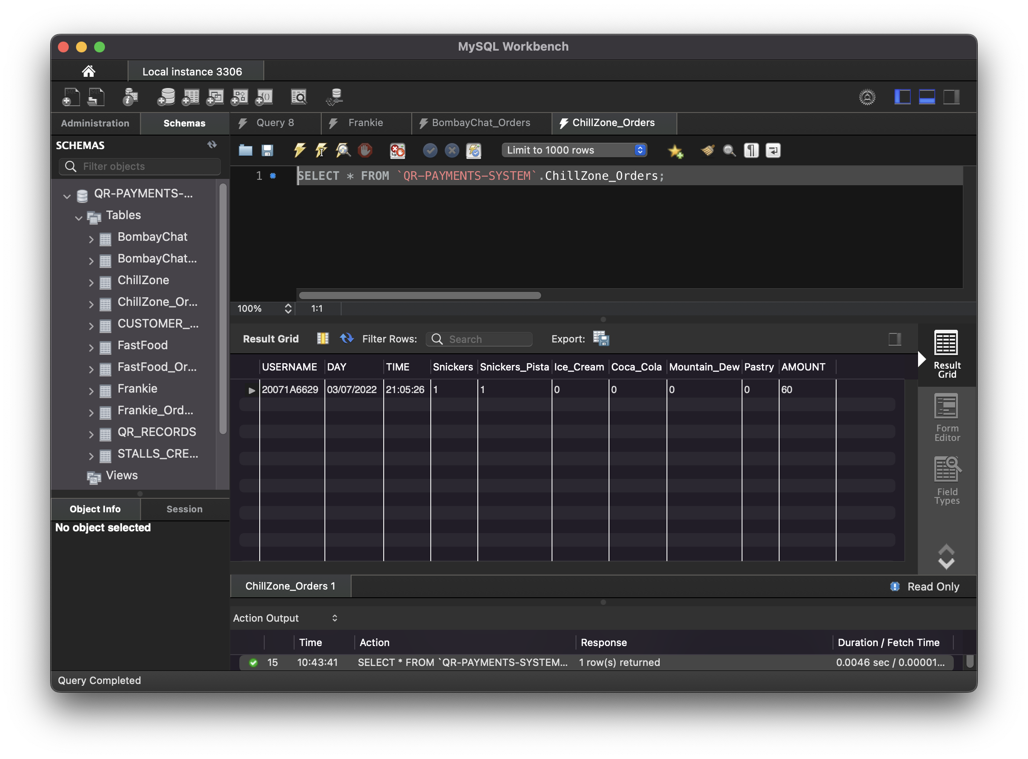
ChillZone Orders Table:
This table stores the details of order details of the ChillZone Food stall.

Slide 27
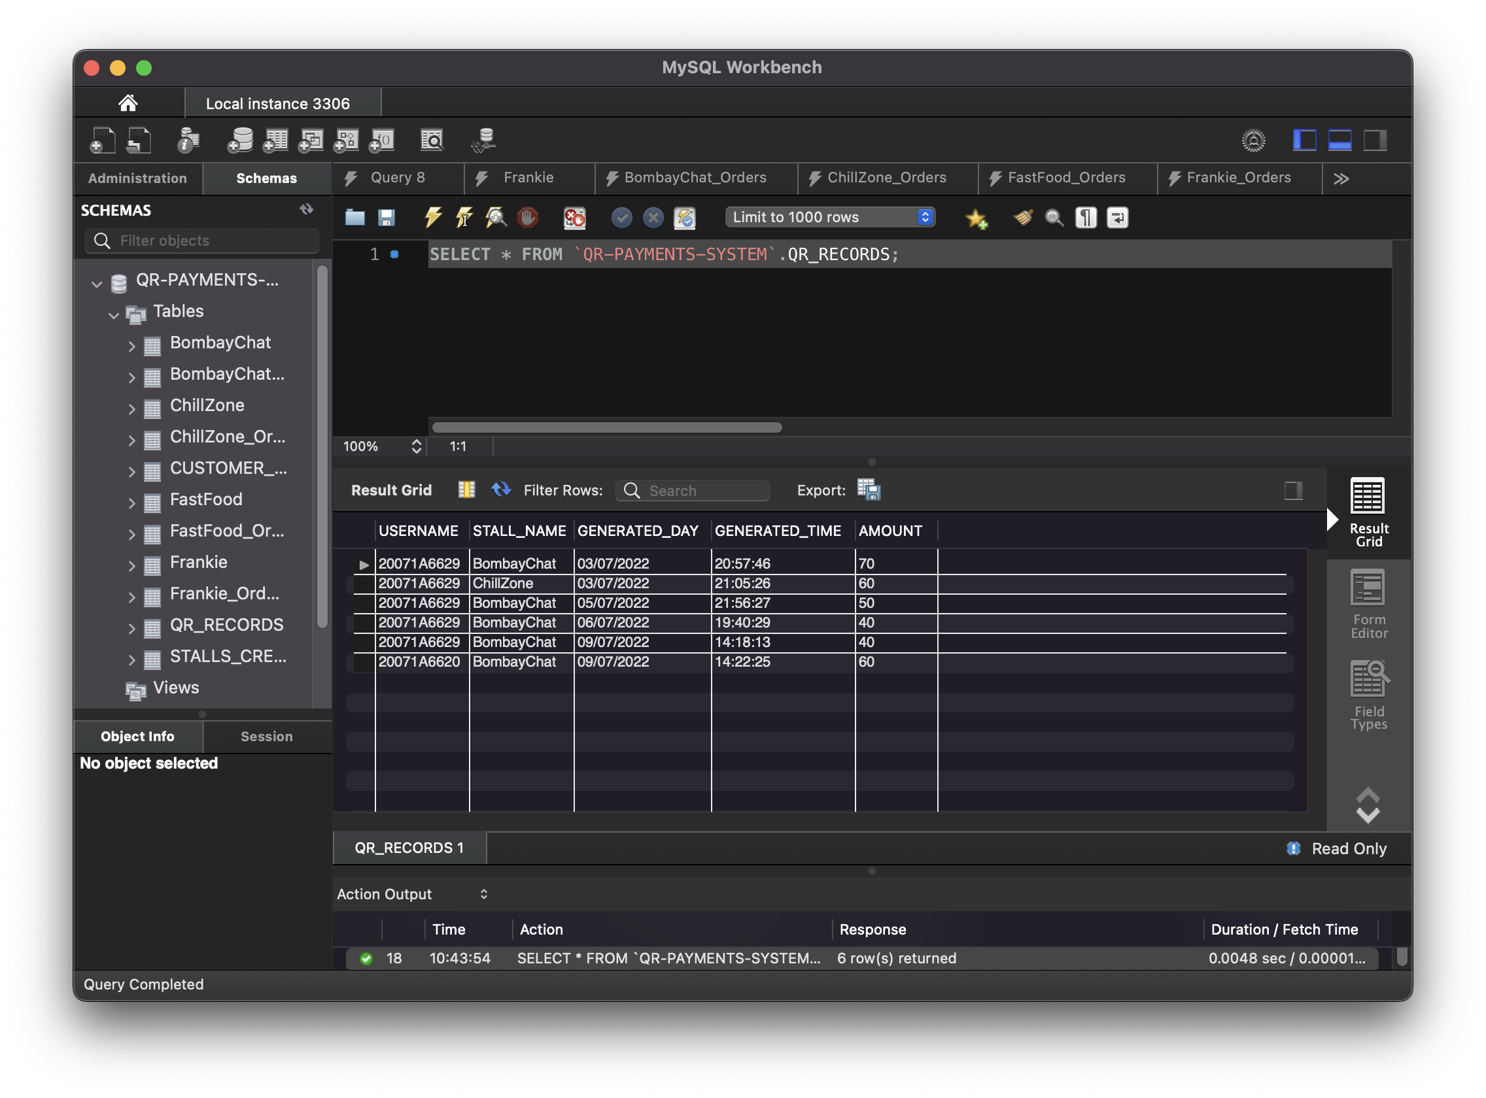
QR Records Table:
This table stores the records of all valid QR codes.

Slide 28
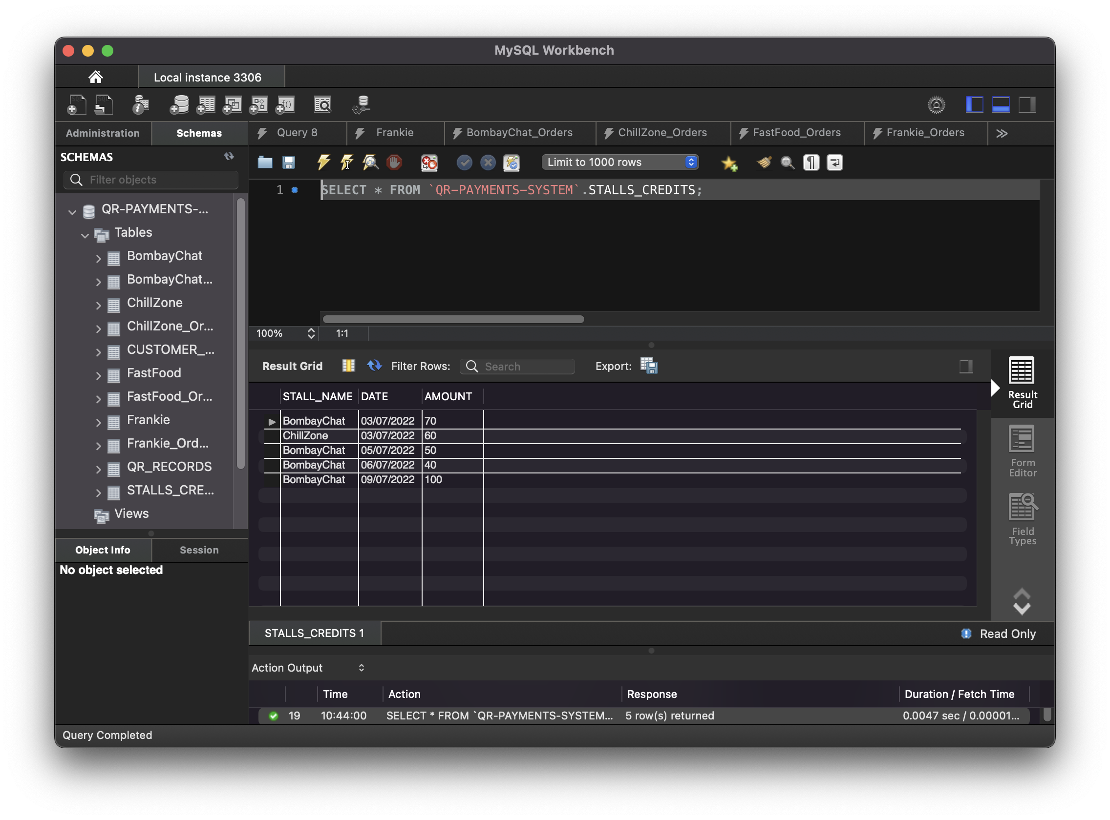
Stall Credits Table:
This table stores the amount credited by student food orders with respective to
each day for a particular food stall.

Slide 29
Thank you…!

